Slide 1
Using Unity as an Animator and Simulator for PaypyrusRT Models
By: Michal Pasternak
Notes:
My name is Michal Pasternak, and I will be talking about using Unity for Animating and Simulating PapyrusRT models.

Slide 2
Agenda
What is Unity?
Why use Unity?
Case Studies
Rover Animation
Car Simulation
Future Work

Slide 3
What is Unity?
Unity is a multi-platform game engine with a built in IDE which enables rapid 3D and 2D game development.
One of the most popular
Game Engines today
Notes:
What is Unity?

Slide 4
Why do people use Unity?
Unity makes it easy to create a game or 3D environment through the use of a graphical editor.
Large collection of user created content and features available for free or purchase.
It allows for quick deployment of a game to many platforms at once. 21 supported platforms, from desktop to mobile and game consoles.
Notes:
Why is Unity popular and why do people use it?
1.
2. (for free and purchase)
3.

Slide 5
Why Use Unity for Simulation?
Easy to quickly build a graphical model that mimics the functionality of an embedded system.
Present information in a fun and visually appealing way
Test the business logic of a model without the need to physically run the system on hardware.

Slide 6
Motivation for Using Unity
Why not use an existing simulator?
Custom control of simulation parameters and environment
Leverage the available content and multiplatform capabilities of Unity.
Ability to customize communication between simulation and control model

Slide 7
Rover Case Study
Goal was to mimic, in 3D, the functionality of a Raspberry Pi rover, such as to eliminate the need of hardware for model testing.
Model needed to be visually appealing, therefore needed to be complex to be more interesting.
Much time and skill is required to produce complex 3D models.

Slide 8
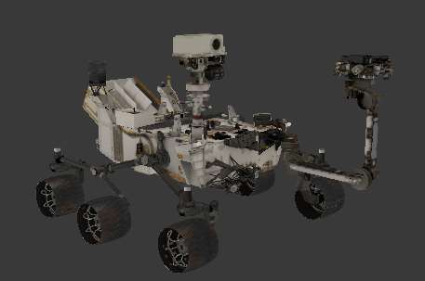
Rover Model Solution
Use freely available material and import into Unity.
For Example: NASA 3D model of the Curiosity rover
- 26,423 Faces.

Slide 9
Screen Shot of Model Animation

Slide 10
Car Simulation Case Study
Goal was to create a testing environment and a simple set
of tools to create many test cases quickly. For example;
driving from point A to B to C along a track.
Have feed back from the simulation alter decisions that
are made by the
control model

Slide 11
Car Simulation Scenario
Control model would obtain parameters from simulation, such as speed, distance to destination, and orientation to make decisions.
The car would respond to inputs provided by the control model. Such as increasing the throttle, changing the steering angle, increasing braking force.
Goal was for the control model to successfully drive to the end destination and stop within 10 meters.

Slide 12
Car Simulation Screenshot

Slide 13
Current Work Status
Successfully implemented bidirectional communication between animation and control model, thus creating a simulation environment.
Currently a simulation can be hand made to a particular scenario and environment, and the model can be tested on it.

Slide 14
Future Work
Goal
To create a tool that will allow for easily customizing a simulation environment for testing PapyrusRT models with out the need for hardware.
Tool Requirements
Customize simulation parameters with out having to edit any Unity code
Add custom environments and objects to conduct varied test cases

Slide 15
Future Work
Composed of three components
Simulation Creator
Unity Animator and Simulator
PapyrusRT model for running and testing output

Slide 16
Future Work
Simulation Creator: Domain specific language used to define the customization of the simulation.
Generates
Generates
Model Library to control the simulated object
Unity code to simulate the defined object
Used by
Creates
PapyrusRT Model
Simulator
Input and Output
Notes:
Simulation Creator: A domain specific language to describe the environment, the controlled object, and what is to happen in the simulation and how to control it through the model.
Unity Animator/Simulation: Generated based on criteria described in the Simulation Creator. Visual animation of object, environment and interactions. Produce relevant output from the simulation to the Papyrus Model.
Papyrus Model: The control model will take feedback from the simulation and provide it with inputs.

Slide 17
Thank You
Thank You!

